Slide 1
CSCI940 CS Research Methodology Autumn Session 2020
Tutorial
2020-10-22

Slide 2
Highlights of Tutorial Lecture
Writing Literature Review (current assignment)
Writing Research Proposal(next assignment)
Some problems in academic writing
Note: Some slides are copied from Prof. Yu

Slide 3
Writing Literature Review

Slide 4
How to organize studies
Chronological
By publication date
By trend
Thematic
A structure which considers different themes
Methodological
Focuses on the methods of the researcher, e.g., qualitative versus quantitative approaches

Slide 5
Making links between studies
Agreements
Similarly, author B points to…
Likewise, author C makes the case that…
Author D also makes this point…
Again, it is possible to see how author E agrees with author D…
Disagreements
However, author B points to…
On the other hand, author C makes the case that…
Conversely, Author D argues…
Nevertheless, what author E suggests…

Slide 6
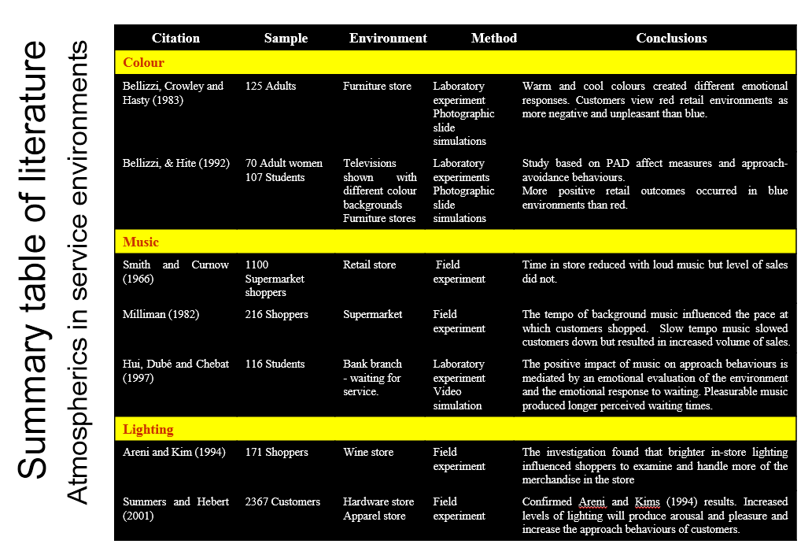
Summary table

Slide 7
Writing Research Proposal
(next assignment)

Slide 8
Research Proposal
A research proposal is a document proposing a research project, generally in the sciences or academia, and generally constitutes a request for sponsorship of that research. Proposals are evaluated on the cost and potential impact of the PR, and on the soundness of the proposed plan for carrying it out. PR generally address several key points:
What research question(s) will be addressed, and how they will be addressed
What cost and time will be required for the research
What prior research has been done on the topic
How the results of the research will be evaluated
How the research will benefit the sponsor and other parties

Slide 9
Types of Research Proposal
Government Research Plan Proposal
Group Research Proposal
NSFC Research Proposal
Technology Research Proposal
Industry Project Research Proposal
Development Project Research Proposal
Research Proposal for Master/PhD application
Thesis/Dissertation Research Proposal
Course Project Research Proposal
Task Research Proposal

Slide 10
Writing Thesis/Dissertation Proposals: The Big Picture
Your proposal describes your proposed plan of work:
What you intend to study (scope and research questions).
How you intend to study your topic (methodology).
Why this topic needs to be studied (significance).
When you will complete this work (timeline).
(Occasionally) Where you will conduct this work.
Notes:
These points are variations on the journalist’s basic questions: who, what, when, where, how, and why.

Slide 11
Parts of a Proposal
Title
Abstract
Introduction/Background
Problem Statement
Purpose/Aims/Rationale/Research Questions
Review of Literature
Methodology
Significance/ Implications
Plan of Work
Bibliography

Slide 12
Some problems in
writing

Slide 13
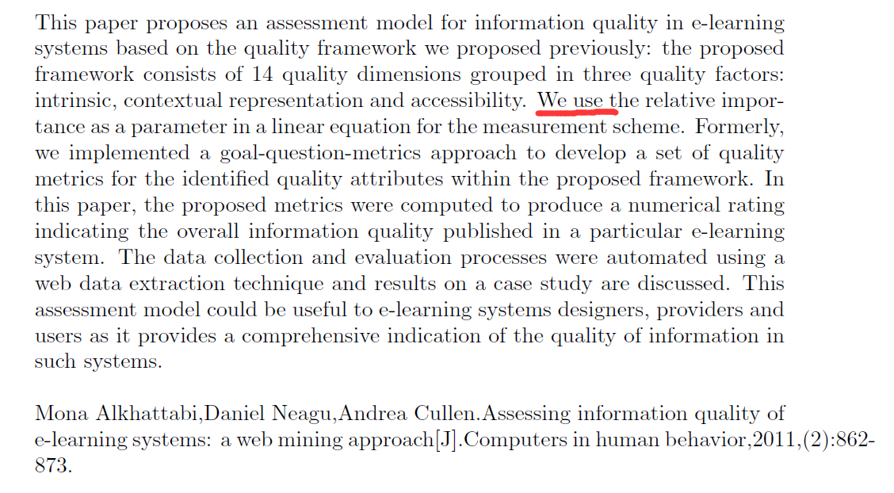
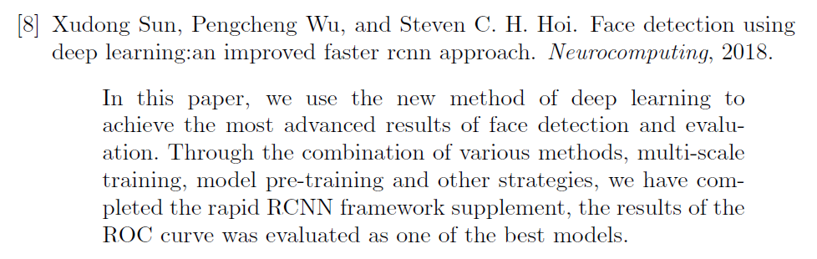
避免使用第一人称
This one copies directly from the paper !!!

Slide 14
Last Tips
Practice!
Practice !
Practice !
Practice !
Practice !

Slide 15


